Slide 1
TILA [ONLINE] INTERNATIONAL MOOT COURT COMPETITION ON ENERGY & INTERNATIONAL LAWS (TIMCCE 3)
7th -11th October 2020
www.tila.in
www.dgef.in

Slide 2
WHAT IS TIMCCE ?
TIMCEE is world’s 1st Moot Court Competition on Energy Laws.
TIMCCE is open for all Law Students from across the world.
TIMCEE was founded on 150th Birth anniversary of Mahatma Gandhi in 2018.
Motto and mission of TIMCCE is to make RIGHT TO ENERGY a Fundamental Right in all the Constitution of the world & to include Right to Energy as a basic human right in the Universal Declaration of Human Rights.
www.tila.in
www.dgef.in

Slide 3
OBJECTIVE OF TIMCCE
TIMCCE, i.e., TILA International Moot Court Competition on Energy & International Laws is a Moot Court Competition to bring in awareness about Energy Laws amongst the Law candidates across the World.
Foster Industry academic partnership in energy sector to develop employment opportunity for law students & Provide talent to energy sector.
To sensitize and involve the community especially law students about prevailing challenge of climate change and energy poverty.
The Competition involves collaboration with Judges from courts and tribunals, professors of law/Management/Engineering, Members of Judiciary / Electricity Regulatory Commission, Stakeholders and others including Legal (heads)/General Counsels of Energy Sector.
www.tila.in
www.dgef.in

Slide 4
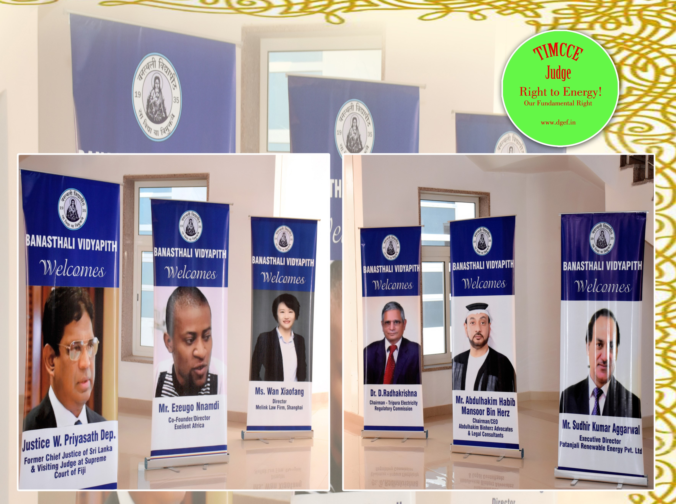
Judges of TIMCEE I & II
www.tila.in
www.dgef.in

Slide 5
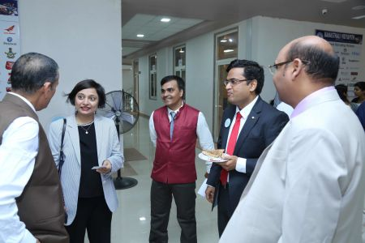
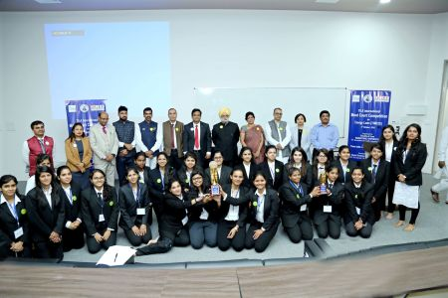
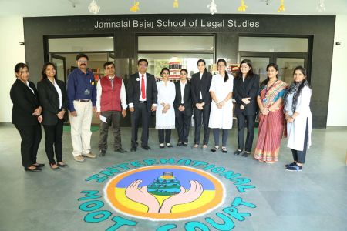
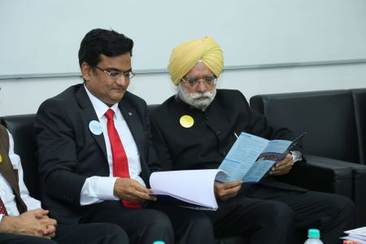
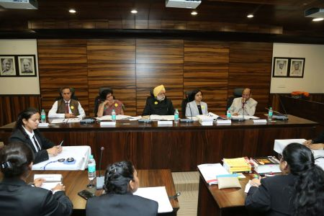
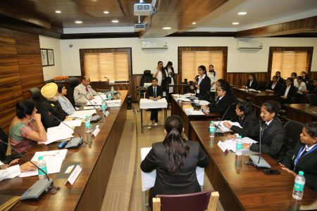
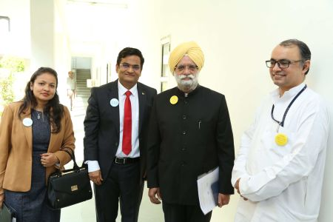
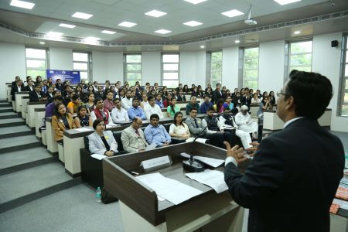
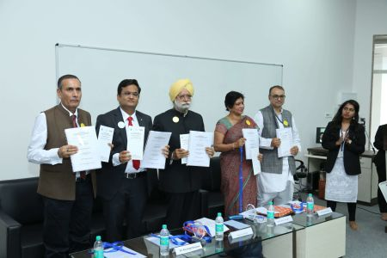
HIGHLIGHTS OF TIMCCE- I- 2018
www.tila.in
www.dgef.in

Slide 6
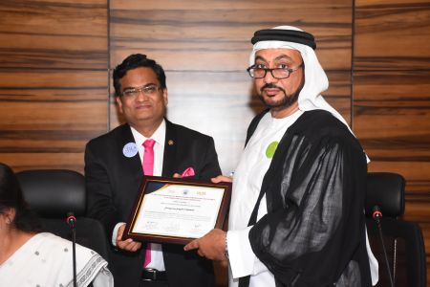
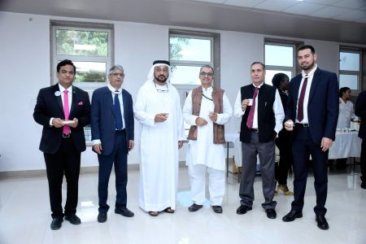
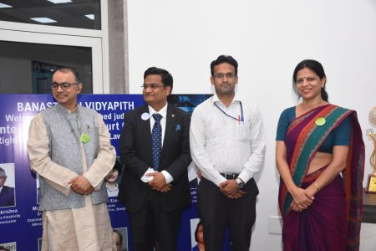
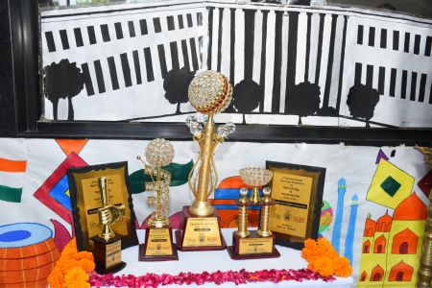
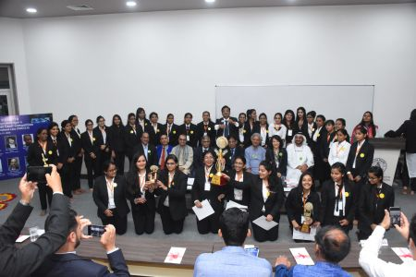
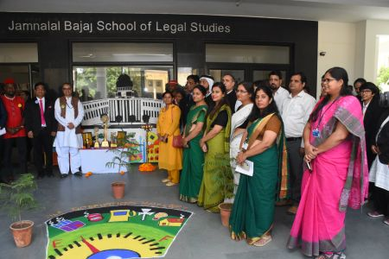
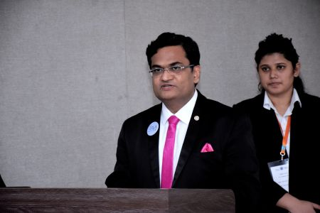
HIGHLIGHTS OF TIMCCE- II- 2019
www.tila.in
www.dgef.in

Slide 7
Roots OF TIMCCE
 | ORGANIZER | Dr. Gopal Energy Foundation (DGEF) is a non-profit organization with motto of “Energy for all” . DGEF is working to make Right to Energy a fundamental human right as a solution for fighting Climate Change & removing curse of Energy Poverty through engagement with Energy sector across the world. (www.dgef.in)
 | ACADEMIC PARTNER | Banasthali Vidyapith university is the largest residential women university in the world, situated in Rajasthan, INDIA. (www.banasthali.org)
 | KNOWLEDGE PARTNER | TILA is corporate Law firm specializing in Energy Laws & Food Laws. TILA is the worlds largest Law firm in Energy sector providing a range of legal services, both inbound and outbound. The firm has 10786 professionals (Attorneys /Company Secretaries /Chartered Accountant) covering all the district of India & 51 Global Partners across the world in order to ensure fully integrated legal services in various jurisdictions. (www.tila.in)
www.tila.in
www.dgef.in

Slide 8
ABOUT BANASTHALI VIDYAPITH
Banasthali Vidyapith is a fully residential women's higher education institute which offers an integrated education system. It was on October 6, 1935 that Smt. Ratan Shastri and Pandit Hiralal Shastri founded Banasthali. Over these 75 years Banasthali has developed into a National Centre for women's education.
Faculty of Law, Jamnalal Bajaj School of Legal Studies under the patronage of Banasthali Vidyapith is recognized by Bar Council of India and UGC. The undaunted efforts of the Faculty of Law and avidity seen in this department of Banasthali Vidyapith are unmatched. The students of the law department therefore thrive to live up to the ideals of Banasthali Vidyapith.
www.tila.in
www.dgef.in

Slide 9
DR. GOPAL ENERGY FOUNDATION
Dr. Gopal Energy Foundation (www.dgef.in) Dr. Gopal Energy Foundation (DGEF) is a non-profit organization with motto of “Energy for all” . DGEF is working to make Right to Energy a fundamental human right as a solution for fighting Climate Change & removing curse of Energy Poverty through engagement with Energy sector across the world. Some of the flagship initiatives of DGEF are:-
Global Energy Arbitration Centre (IEAC) New Delhi
TILA International Confex on Energy (The 5th Edition of TICE will be organized along with Solar World Congress from 24th to 28th October 2021)
Electricity Laws- Online Certificate Course
TILA International Moot Court Competition on Energy & International Laws (TIMCCE)
Training/Workshop for capacity building in Energy Sector
Publications of Technical Documents & Journal (Energy for All)
International Confederation of Energy Industry (ICE-I)
www.tila.in
www.dgef.in

Slide 10
TRANS INDIA LAW ASSOCIATES
TILA (www.tila.in) is corporate Law firm specializing in Energy Laws & Food Laws. TILA is the worlds largest Law firm in Energy sector providing a range of legal services, both inbound and outbound. The firm has 10786 professionals (Attorneys /Company Secretaries /Chartered Accountant) covering all the district of India & 51 Global Partners across the world in order to ensure fully integrated legal services in various jurisdictions. (www.tila.in) The Partners and members of the firm are professional having decades of experience. They are in tune with the work culture of international law firms as well as with the expectations of Start ups and corporate clients; and bring in the highest level of professional service keeping up to the firm’s mission- “Salute to Work!”. TILA’s range of services include:-
1. Contract Management (Drafting, Reviewing, Red Lining & Settling Agreements);
2. Legal Representation before Regulators & Courts across the world;
3. Land Acquisition & Real Estate Compliance;
4. Project Finance & Customized Documentation;
5. Joint Venture & SPV in India, including incorporation of Company;
6. Corporate & Secretarial Compliances and Labour & Business Compliances;
7. IPR Protection for organization (Trade Mark/ Copy rights/ Designs/Patents/GI etc.;
8. Audit Service, Management & Tax Consultancy.
9. Domestic and International Arbitration. 10. Transaction Advisory
www.tila.in
www.dgef.in

Slide 11
DATES & ELIGIBILITY
TIMCCE-III-2020 is scheduled to be organize from 7th -11th October 2020 through Online mode.
Eligibility: Students pursuing law degree from any University are eligible to apply for registration of their team. However only one team shall be allowed to participate from one law institution.
www.tila.in
www.dgef.in

Slide 12
TIMCCE- III- 2020: Moot Problem
United States of Dgem V. Union of Tilawin
(Will be shared post registration)
www.tila.in
www.dgef.in

Slide 13
Registration process (Form 2)
The duly filled registration forms should reach latest by on or before 31st August 2020 by 23:59 hrs through email at administrator@dgef.in with subject title “Final Registration”.
Registration is on first cum first serve basis. Moreover only one team is permissible from one University. So, interested applicants are kindly requested to register themselves at the earliest.
www.tila.in
www.dgef.in

Slide 14
Team s from | Registration Fees
High Income Nations | 600 USD/INR 41,400/-
Upper Middle Income Nations | 350 USD/INR 24,150/-
Lower Middle/ Low Income Nations | 200 USD/INR 13,800/-
The registration fee for participation in the International Rounds is based on the World Bank list of Economies.
The fee is to be paid to Dr. Gopal Energy Foundation (DGEF).
The details provided for formal registration will be final for the purposes of certification and awards.
Once the registration fee paid by the team will neither be refunded nor waived. However change in team composition will be considered.
www.tila.in
www.dgef.in

Slide 15
TIMCCE- III- 2020 : Program Plan
TIMCEE- III- 2020 (PROGRAM PLAN) | IMPORTANT DATES
Last Date of Final Registration | 31st August, 2020
Dispatch Team Codes to Participating Teams | 5th September, 2020
Last Date for submitting copy of the Memorial | 15th September, 2020
TILA International Moot Court Competition on Energy and International Laws (TIMCEE- III) | 7th^{th} & 11th October, 2020
www.tila.in
www.dgef.in

Slide 16
How can I pay?
S.No. | MODE OF PAYMENTS | DETAILS
1. | BY RTGS/NEFT/ BY INTERNATIONAL TRANSFER | Dr. Gopal Energy Foundation, A/c No. 50200021957252, HDFC Bank, Branch Address- PLOT NO.-9, H & J BLOCK, LOCAL SHOPPING CENTRE, SARITA VIHAR, NEW DELHI-110076, MICR Code-110240072, IFSC Code- HDFC0000480, Swift Code-HDFCINBBDEL
2. | BY ECS/CASH DEPOSIT | Deposit cash at any Branch of HDFC across the India in favor of:-Dr. Gopal Energy Foundation, A/c No. 50200021957252
3. | BY DEMAND DRAFT/CHEQUE | The payment (Cheque / DD) should be drawn in favour of Dr. Gopal Energy Foundation, payable at New Delhi.
4. | BY CREDIT CARD/ DEBIT CARD | Swapping Machine Availableat New Delhi Office- Dr. Gopal Energy Foundation, JA-121, 1st Floor, DLF Tower-A, Jasola District Centre, New Delhi-110025
5. | BY PAYMENTS GATEWAY | Pay online through link-http://www.dgef.in/payment
www.tila.in
www.dgef.in

Slide 17
TIMCCE- III- 2020: Prize, Certificates & Awards
S. No. | Champion | TIMCCE Prize, Certificates & Awards
1. | 1st Prize @ TIMCCE III | Cash Prize of USD 500 Certificate- 1st Prize Certificate- Participation 100% scholarship for all team members for Electricity Laws Online Certificate Course awarded by Dr. Gopal Energy Foundation
2. | 2 nd Prize @ TIMCCE III | Cash Prize of USD 250 Certificate- 2nd Prize Certificate- Participation Free Paper Publication in annual publication of DGEF named ‘Energy for All’ having ISBN No. 978-93-5265- 482-6
3. | 3rd Prize @ TIMCCE III | Cash Prize of USD 175 Certificate- 3rd Prize Certificate- Participation Complimentary invitation as distinguished guest to join 5 th TILA International Confex on Energy (TICE 5)
www.tila.in
www.dgef.in

Slide 18
S. No. | Champion | TIMCCE Prize, Certificates & Awards
4. | Best Mooter @ TIMCCE III | Cash Prize of USD 100 Certificate- Best Mooter Certificate- Participation Will be provided one month intensive Internship at TILA Head Office, New Delhi
5. | Best Researcher @ TIMCCE III | Cash Prize of USD 100 Certificate- Best Researcher Certificate- Participation Will be provided one month intensive Internship at TILA Head Office, New Delhi
6. | Faculty Advisor | Certificate of distinguished Faculty Advisor for top three teams. Complimentary invitation to become Associate member of Global Energy Arbitration Centre (GEAC).
7. | Participants | All participating team members will get participation Certificates.
www.tila.in
www.dgef.in

Slide 19
TIMCCE- III- 2020 : Structure of the Competition
The Competition includes
Each level of the Competition consists of written pleadings (Memorials) and oral pleadings (Oral Rounds).
The organizers will determine the exact number of Teams participating in the International Rounds and the manner in which they are chosen, provided that each participating nation is permitted to enter at least one Team in the International Rounds of the Competition. In nations, where only one Team participates, that Team is the National Representative to the world championship Round.
S. No. | Rounds
1. | Preliminary Rounds
2. | Quarter final Round
3. | Semi Final Round
4. | World Championship TIMCEE Round
www.tila.in
www.dgef.in

Slide 20
TIMCCE- III- 2020 : Committee
PATRON - Prof. Aditya Shastri, Vice Chancellor, Banasthali Vidyapith
CONVENER – Prof. Harsh Purohit, Dean, Faculty of Law, Banasthali Vidyapith
ADMINISTRATOR - Mr. Raj Singh Niranjan, Energy Law Expert & Manging Partner Trans India Law Associates (TILA), Legal Adviser, International Solar Alliance (ISA)
CO-CONVENER – Dr. Rajni Patel, President, Dr. Gopal Energy Foundation
CO-CONVENER – Mr. Rashmi Singh Rana, H.O.D., Department of Legal Studies, Banasthali Vidyapith
PUBLIC RELATION OFFICER – Mr. S. Gopalakrishnan, Banasthali University
FACULTY CO-ORDINATOR – Ms. Asha Rani Rawat, Banasthali University
ADMINISTRATOR (CC) – Mr. R.K. Tiwary, Secretary General, Dr. Gopal Energy Foundation, M: +91 -8860635075, administrator@dgef.in / Whatsapp +919810070075
www.tila.in
www.dgef.in

Slide 21
Raj Singh Niranjan
Managing Partner, Trans India Law Associates (www.tila.in)
Founder, Dr. Gopal Energy Foundation (www.dgef.in)
Former Legal Adviser, International Solar Alliance
Legal Adviser, India Africa Youth Energy Forum
Legal Adviser & Co – Chair Solar Business Club
Chairperson, Computer Society of India, Delhi Chapter
President, Global Energy Arbitration Centre
Author of Guide to Electricity Laws in India (First book on Electricity Act 2003)
We seek your support for Energy Revolution to eliminate the curse of Energy poverty and to make Right to Energy a Fundamental Right in all the Constitutional of the world & to include Right to Energy as a basic human right in the Universal declaration of Human Rights.
ww.tila.in
www.dgef.in

Slide 22
For more information, please contact:
WhatsApp +91 9810070075 Email – registrar@dgef.in
Dr. Gopal Energy Foundation
DGEF Secretariat, JA-121, DLF Tower - A, Jasola District Center,
New Delhi-110025
Tel.:91-11-26943664 | Fax: 91-11-26970075
Email: registrar@dgef.in / info@dgef.in| Website: www.dgef.in
www.tila.in
www.dgef.in

Slide 23
REGISTER TODAY & JOIN THE RIGHT TO ENERGY MOVEMENT
www.tila.in
www.dgef.in

