Slide 1
DNIPRO - TCCC OUTPOST
Translated from Ukrainian to English - www.onlinedoctranslator.com
Dnipropetrovsk State
University of Internal Affairs

Slide 2
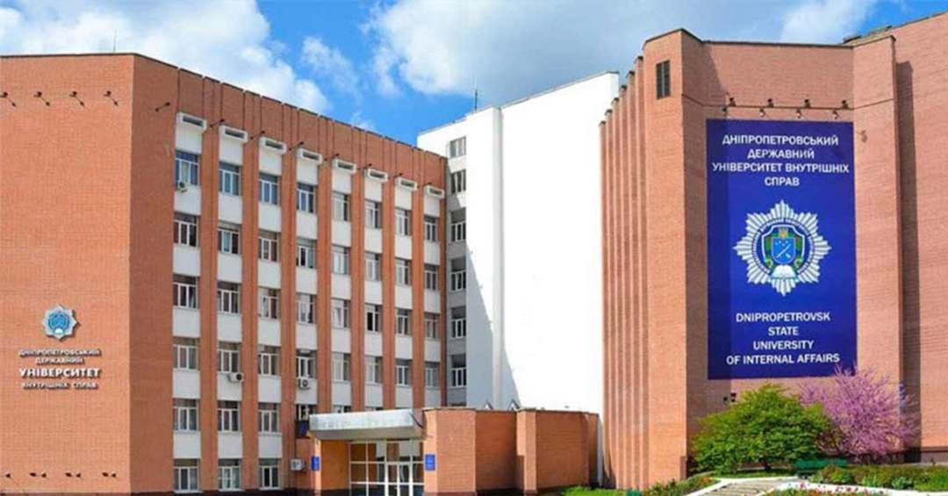
Dnipropetrovsk State University of Internal Affairs:
Face & Logo

Slide 3
Training Specification
Pre-medical training
Department of criminology and pre-medical training
- first step
Tactical medicine
Department of tactical special training
- second step

Slide 4
General:
Training of persons who DO NOT HAVE A MEDICAL
EDUCATION, but are obliged to provide pre-medical care according to their official duties,
and for the purpose ofadapting educational and training programs to international standardsof providing emergency medical care

Slide 5
PURPOSE OF LEARNING
Obtaining knowledge and practical skills from
provision of first aid to the injured taking into account the tactical situation (of varying degrees of danger) for
development of professional competence

Slide 6
Principles:
Outdoor
Available
Practical
Ergonomic
Developing
Effective

Slide 7
How does it work?
Interactive and simulation practical training;
To use training grounds for scenario-oriented practical training, for example: special multimedia shooting range and killhouse or field conditions;
Police quests;
Attracting specialists to conduct classes and exchange experience;
Engagement of practitioners in online and offline lectures;
Free distance learning (Open Source);
platforms using computer technologies;
Qualified and certified trainers (teachers)

Slide 8
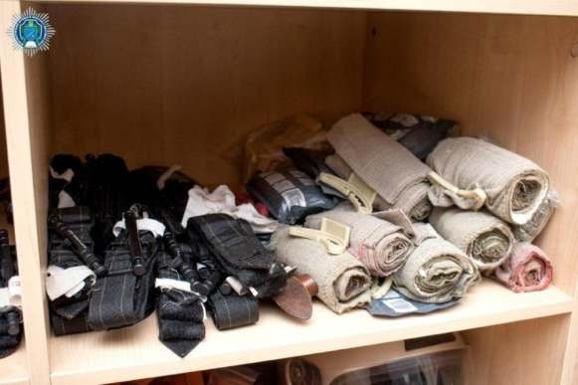
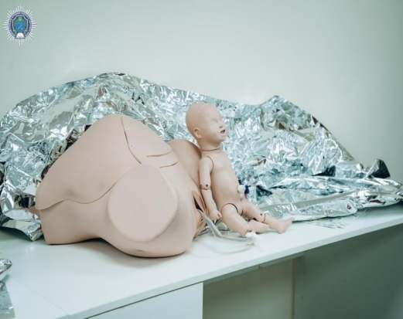
Training grounds

Slide 9
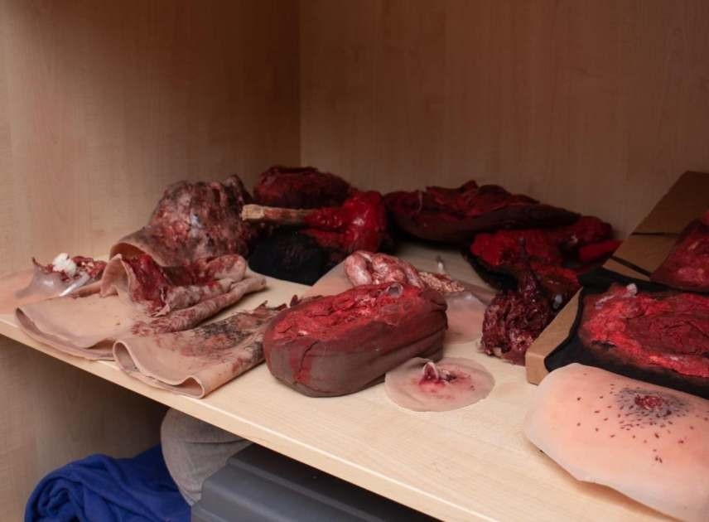
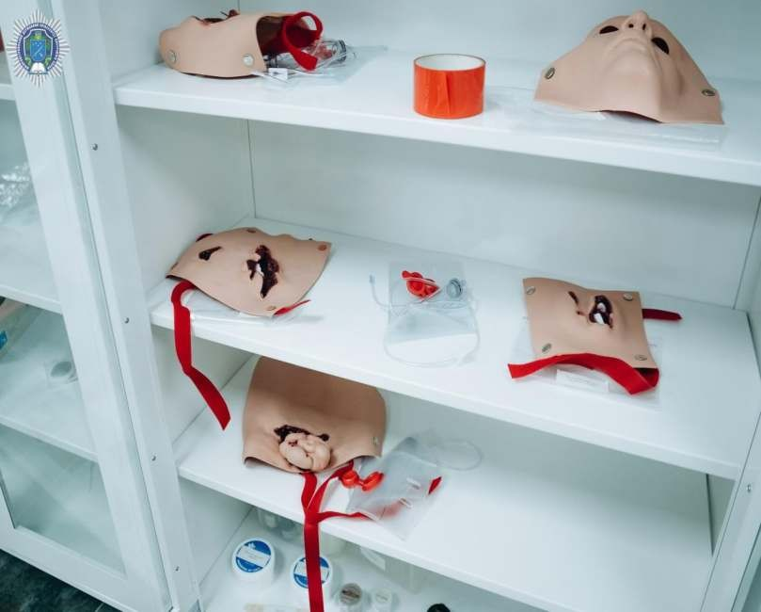
Realistic

Slide 10
Motivated and
qualified trainers

Slide 11
Difference:
Pre Medical Care VS. TCCC / TESS

Slide 12
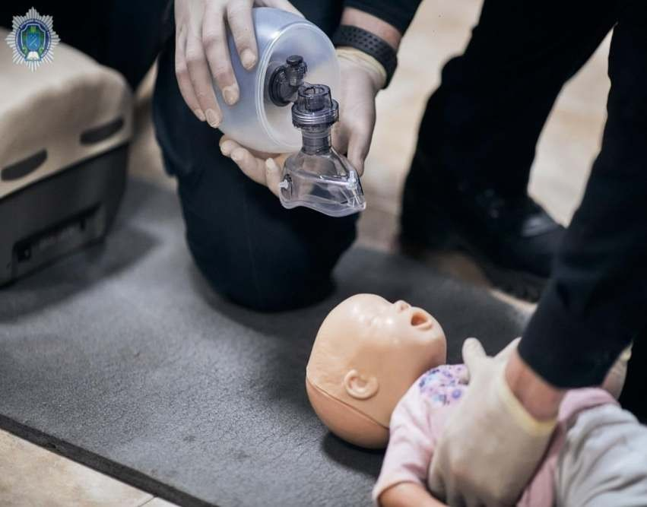
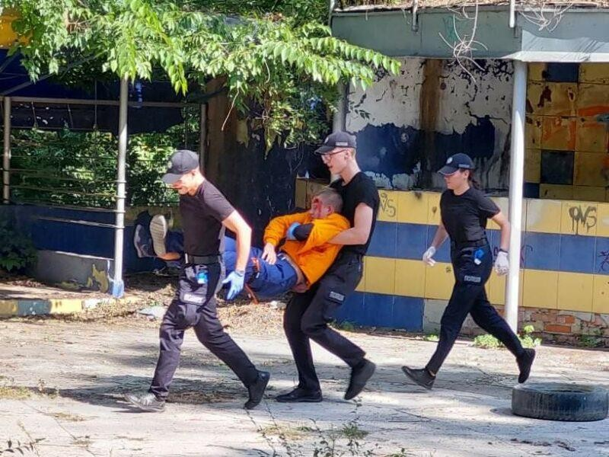
Pre-medicaltraining :
First on the scene

Slide 13
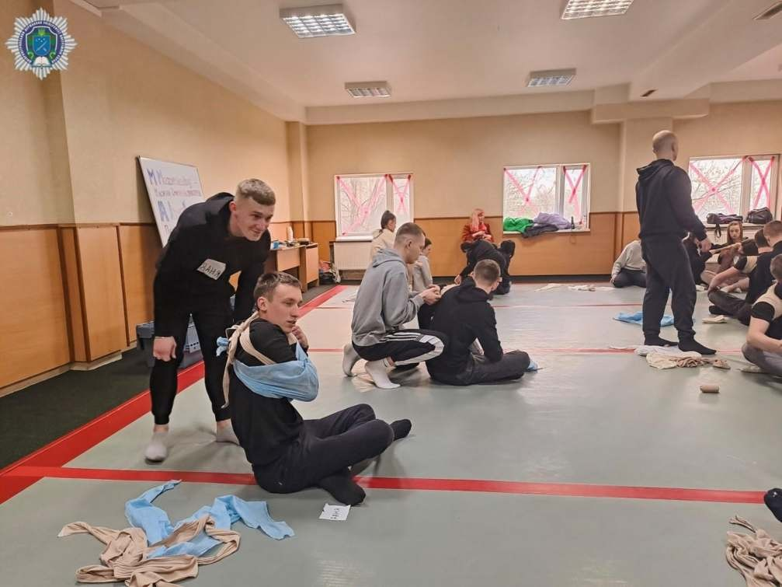
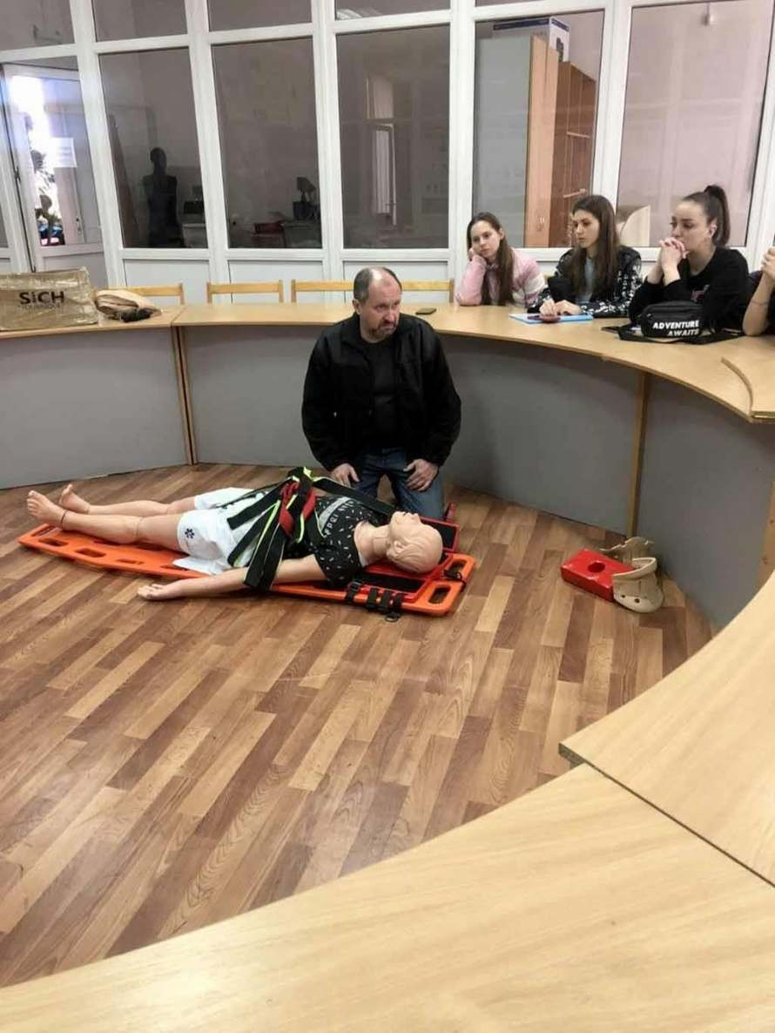

Slide 14
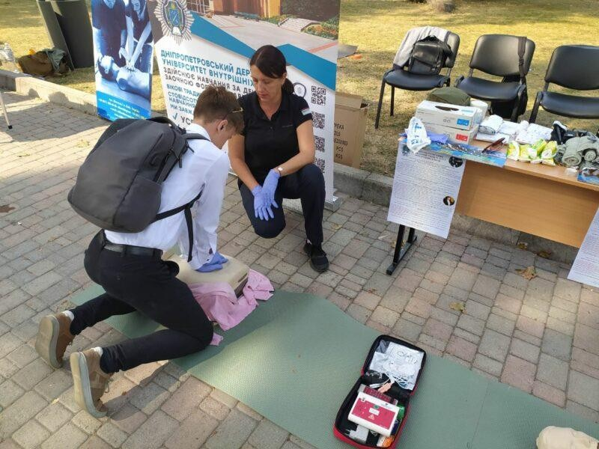
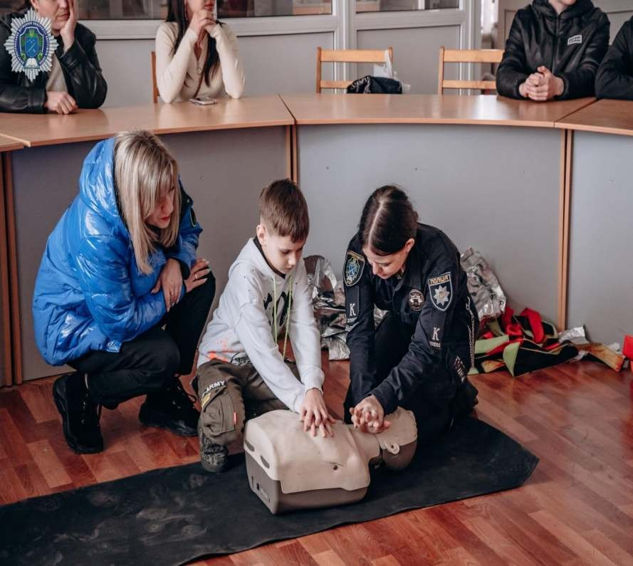

Slide 15
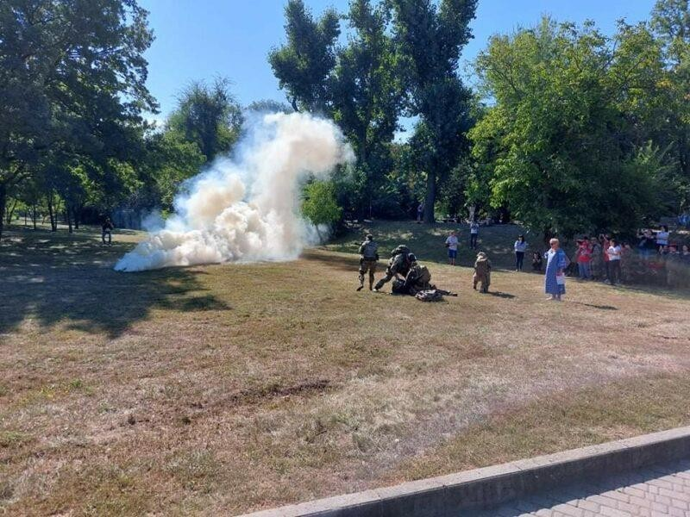
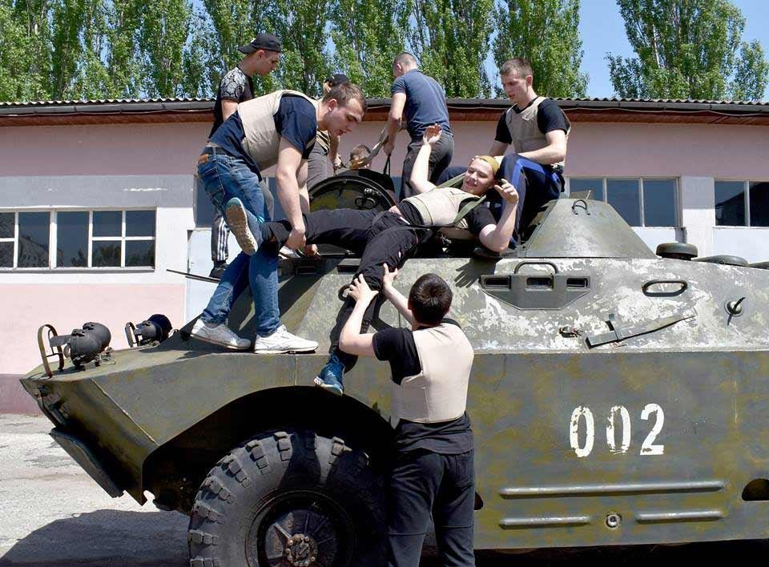
Tactical medicine: TESS

Slide 16
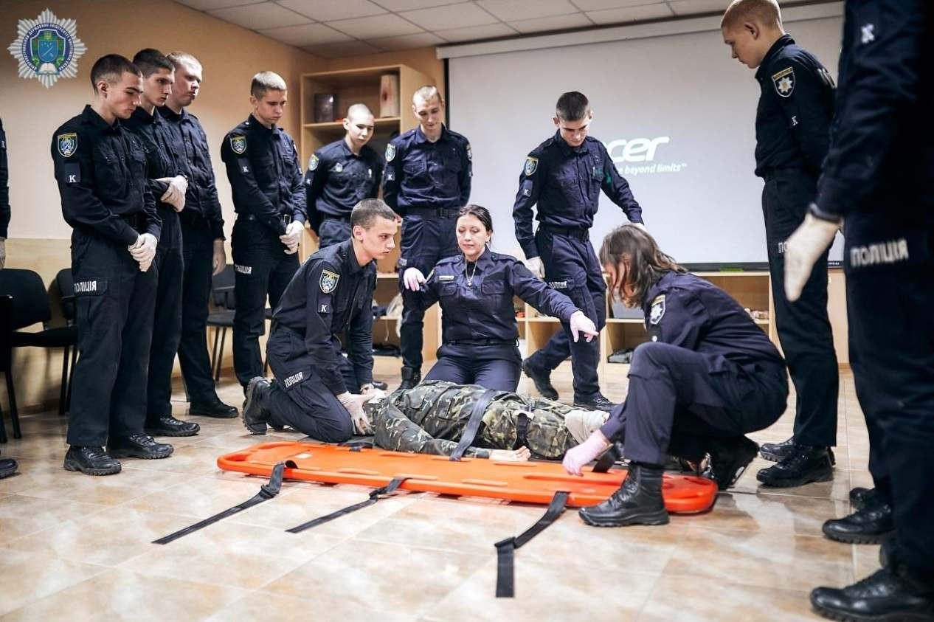

Slide 18
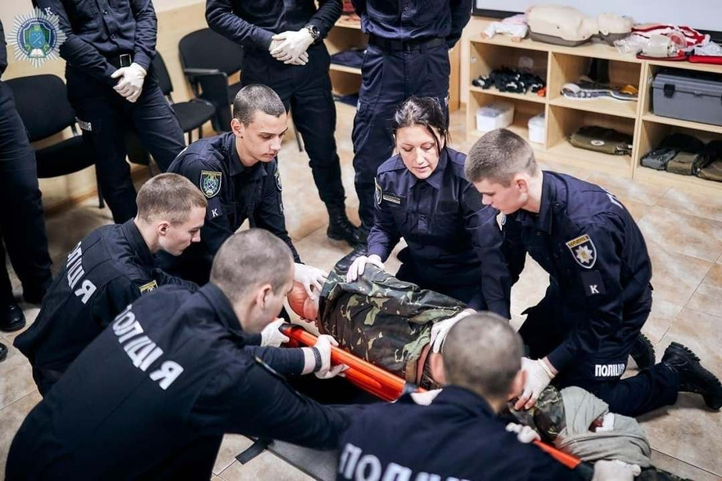
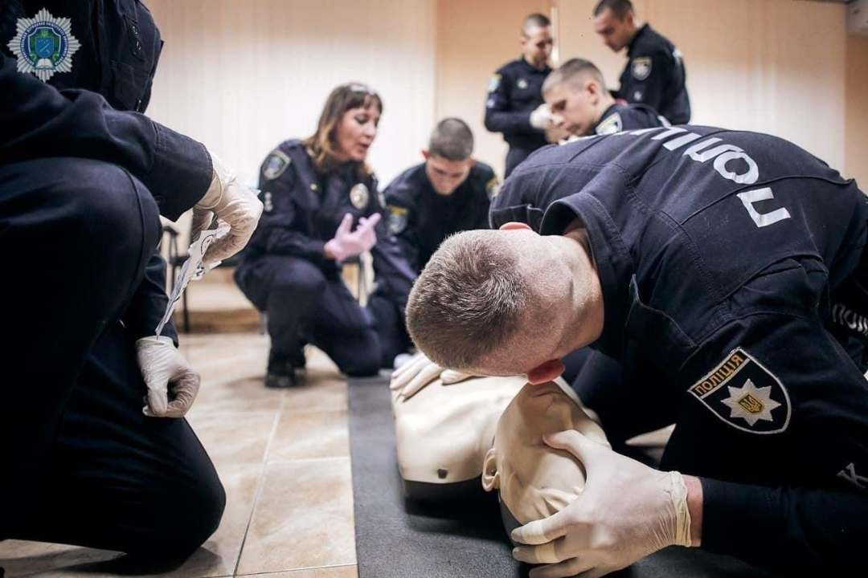

Slide 19
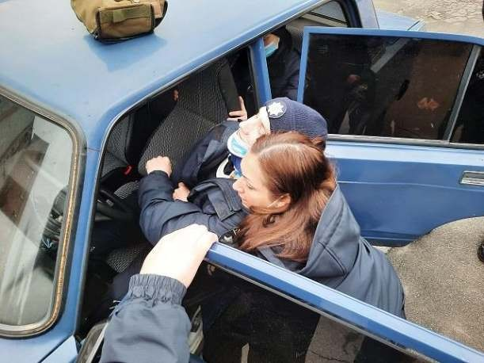
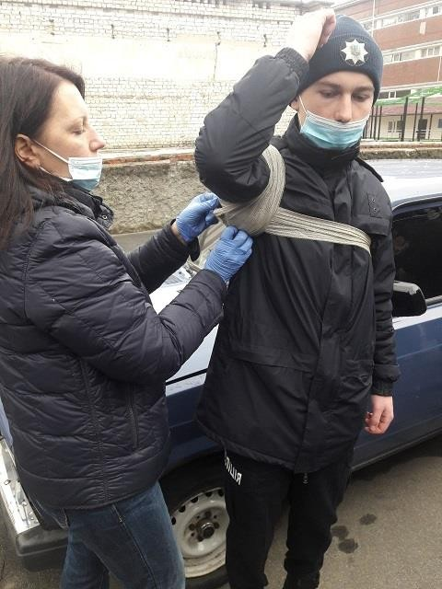

Slide 20
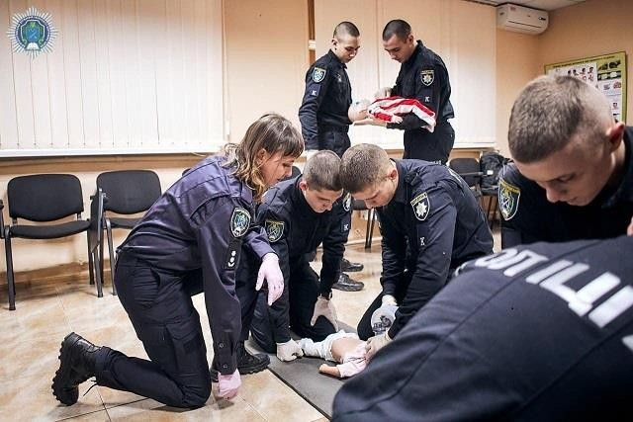

Slide 21
BUT... Russia in Ukraine
- hybrid warfare since 2014
- military aggression since 2022

Slide 22
QUESTIONS?
More and More Sacrifices in Ukraine:
- Combatants
NOT guilty Civilians
Children
WHAT? WERE? HOW? WE CAN HELP
PREVENT IT?

Slide 23
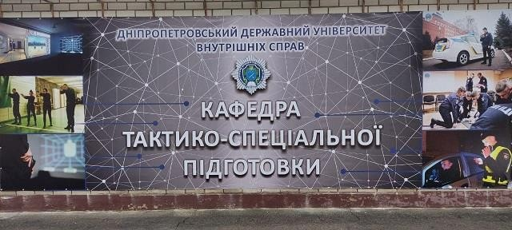
We Have Changed

Slide 24
Challenges
Missile attacks and bomb threats made face-to-face learning impossible
the termination of face-to-face training revealed the need for reorientation and
improvement of the teaching of practical disciplines on distance platforms and the
low ability to test the acquired knowledge and skills
Blackout and lack of Internet in the temporarily occupied territories of Ukraine
The close proximity to the front line and the occupied territories made the Dnipro a shelter for refugees (IDPs) and an outpost for the enemy
- Limited resources and time for conducting classes in full (airborne alarms caused
the need to transfer the educational process to a shelter without specialized educational equipment)
- Reduction of training efficiency (daily training against DRG attacks of all
participants in the training process)
- The need to improve qualifications and reorient the content of training in accordance with new threats (explosive danger, radiological threats)

Slide 25
Answer
Free weekly training of all interested civilians in providing first aid, taking into account personal safety
measures during wartime
Training young people in pre-medical assistance as part of patriotic education, taking into account age characteristics (quests, competitions...)
Preparation of representatives of law enforcement agencies and journalists for the possible threat of shelling (red zone) within the scope of their official activities
Reorientation and inclusion in training programs for tactical and special training of Tactical Medicine, taking into account the international guidelines of the TSSS of representatives of "military professions"
Advanced training for soldiers of the Armed Forces and Territorial Defense from TSSS
Exchange of experience with fellow instructors, coaches, including international cooperation
Self-improvement according to NATO standards for quality training
Scientific activity and receiving grants
Development of methodical materials for conducting classes, manuals, videos for educational classes
Cooperation with the mass media for the sake of global enlightenment

Slide 26
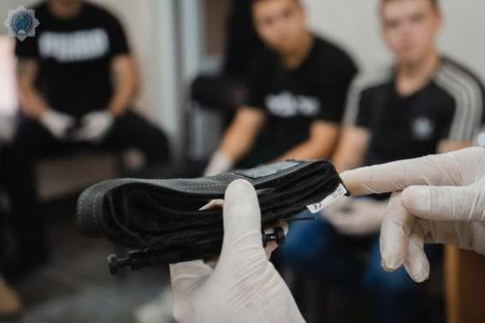
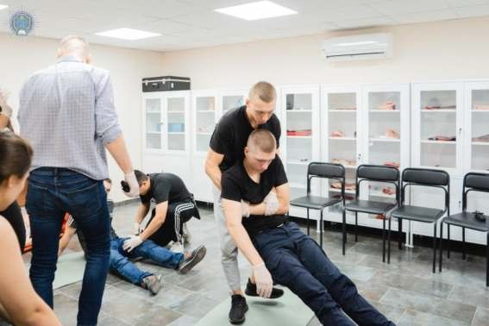
Training of civilians
citizens

Slide 27
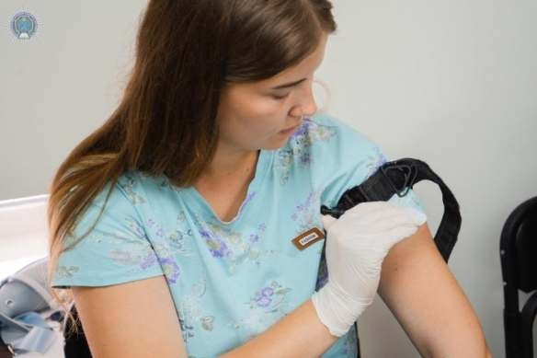
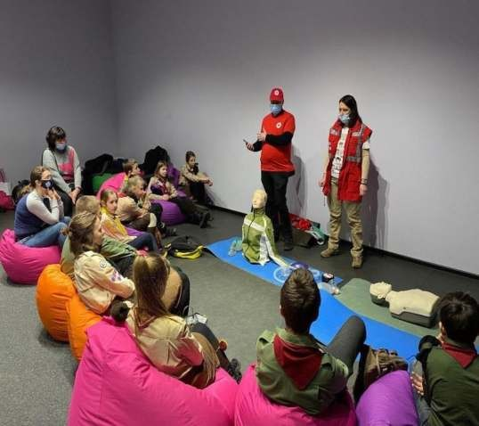
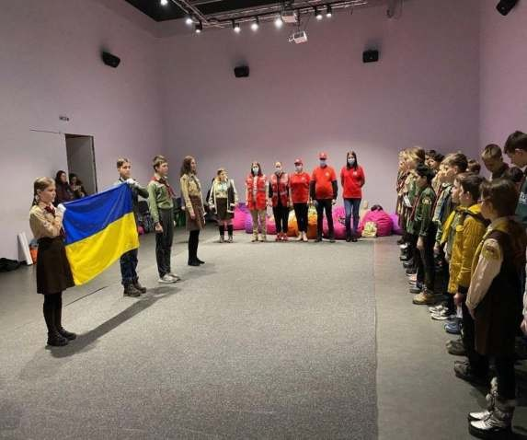
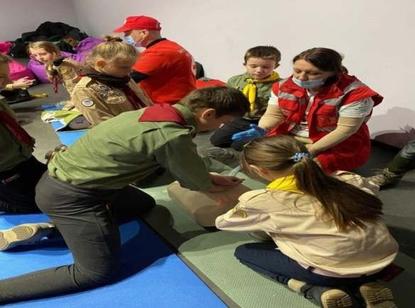
Patriotic education

Slide 28
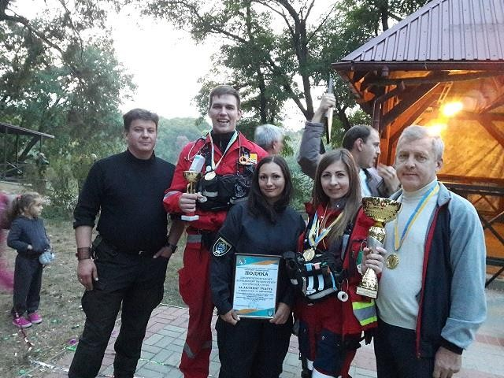
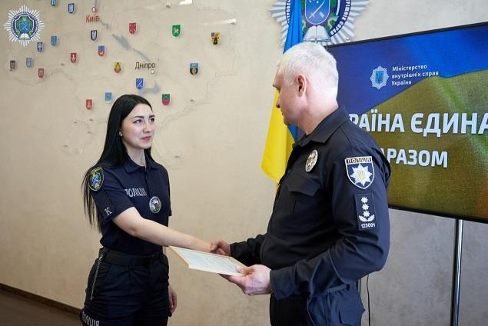
We train young people to win

Slide 29
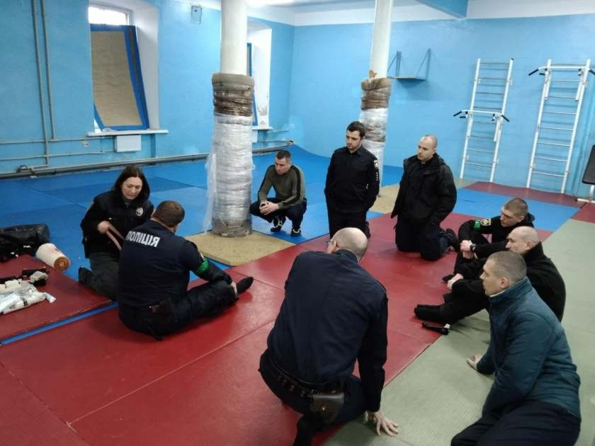
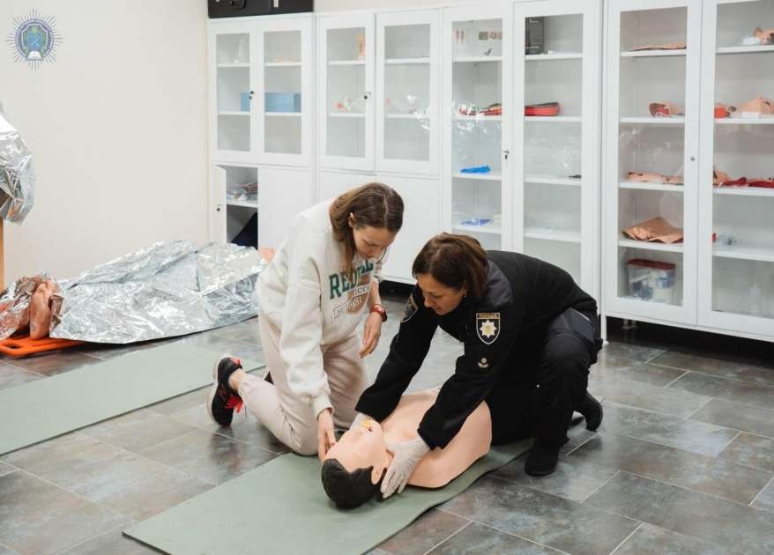
Training of representatives of law enforcement agencies and
journalists

Slide 30
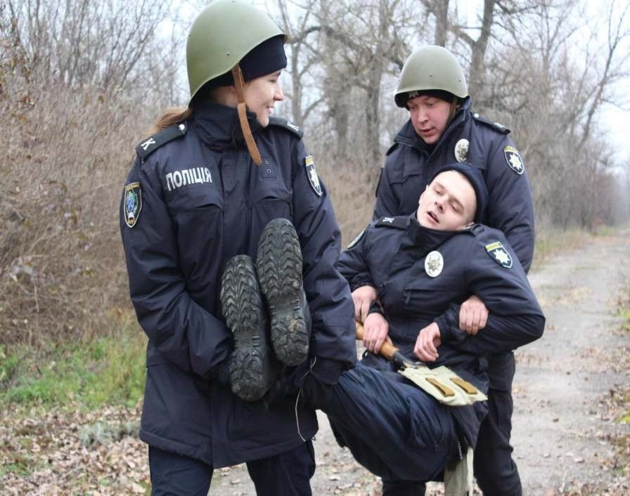
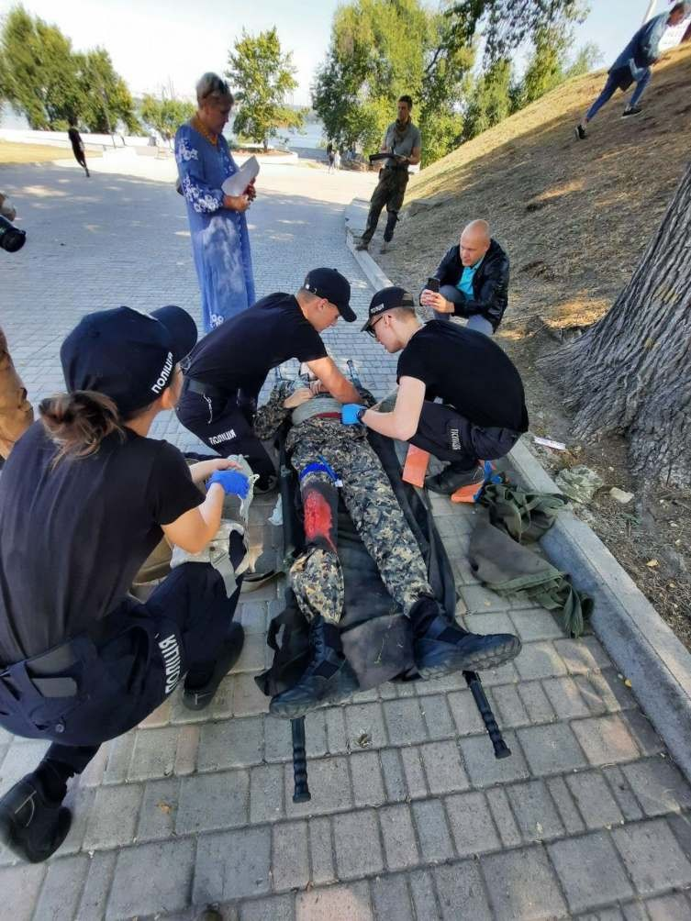
Learning landmarks "military"

Slide 31
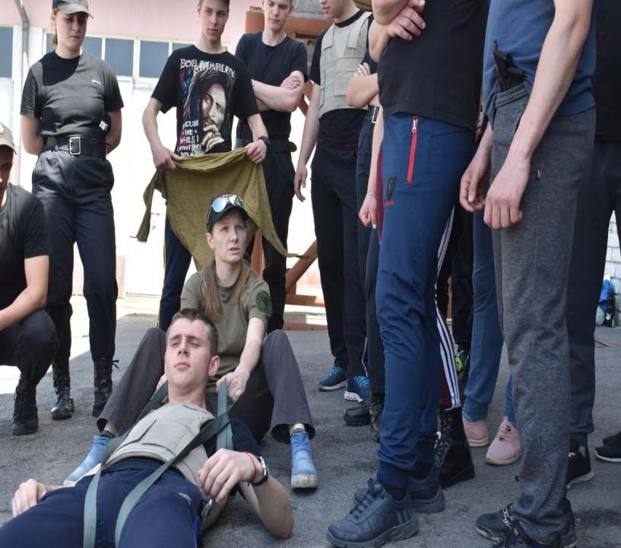
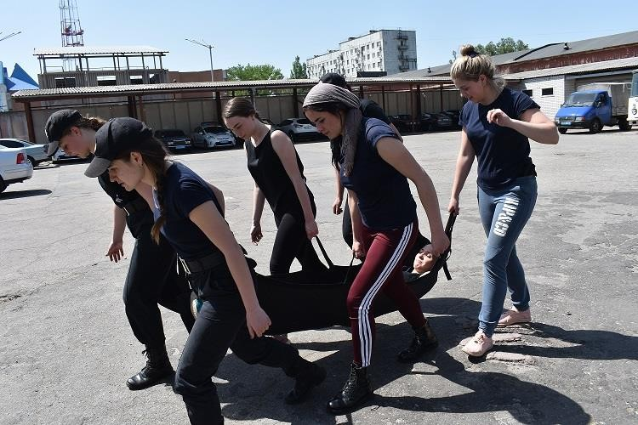
Threat: Evacuation!

Slide 32
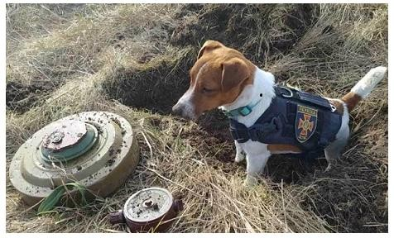
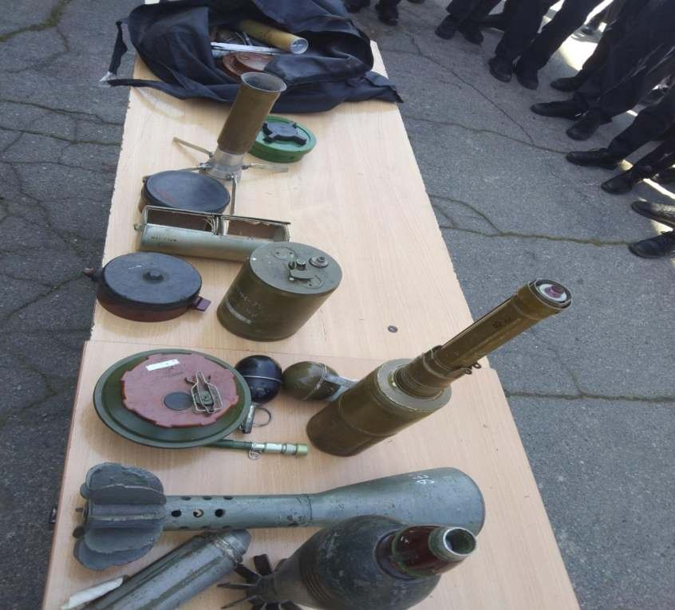
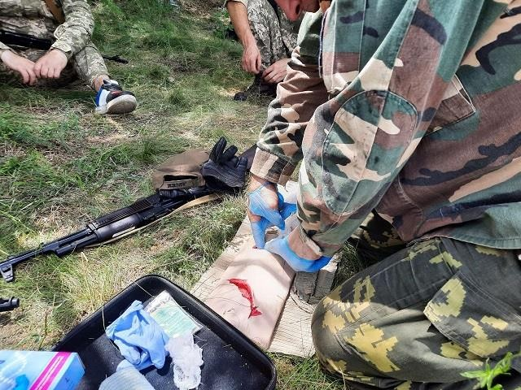
Explosive

Slide 33
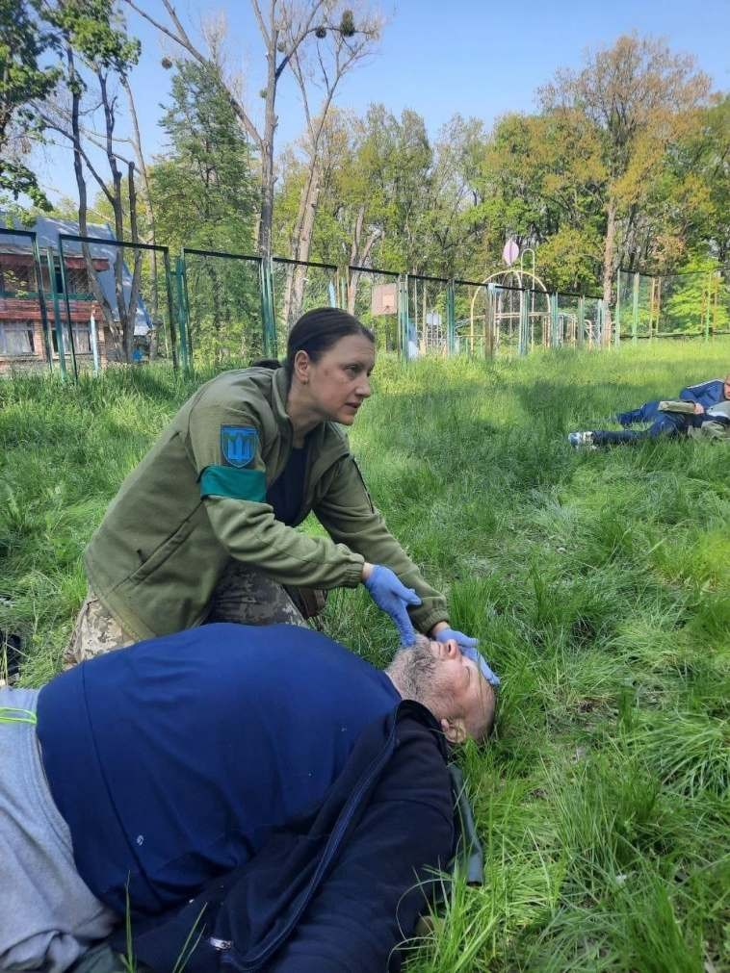
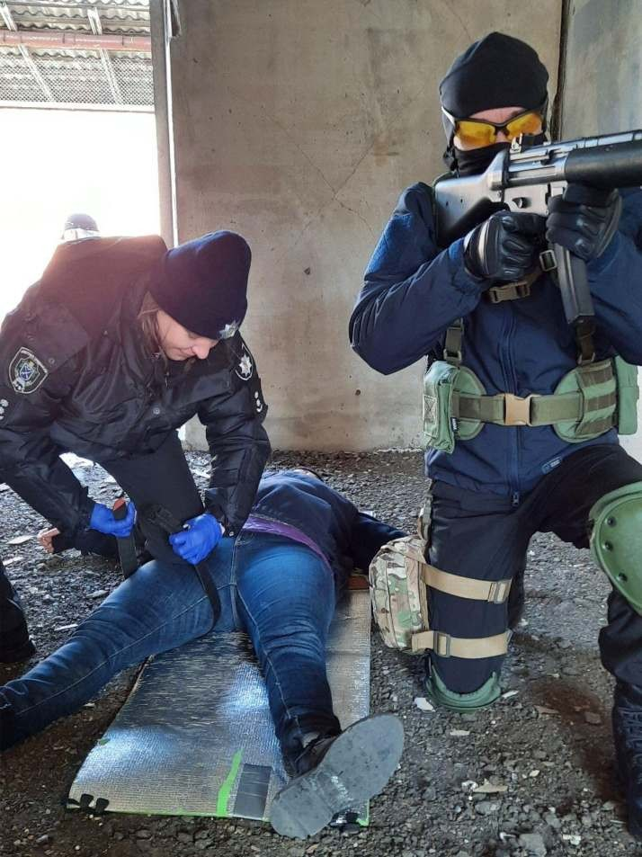
Improving the qualifications of the Armed Forces and territorial defense

Slide 34
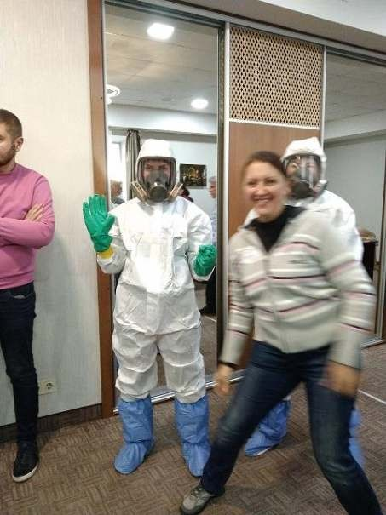
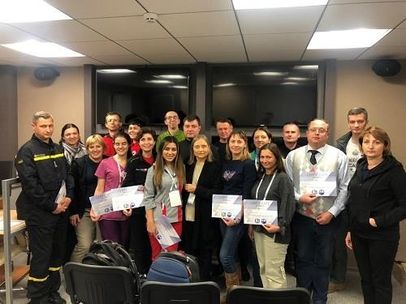
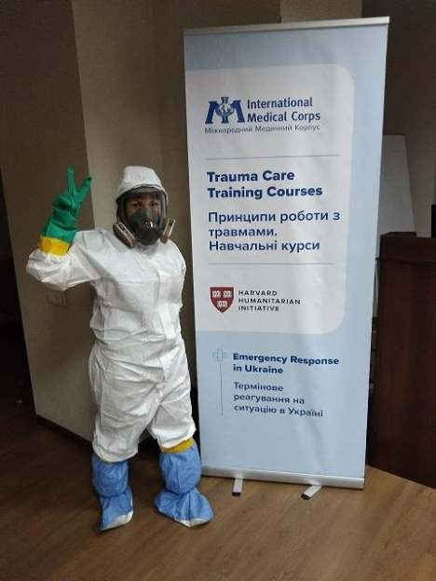
Self improvement

Slide 35
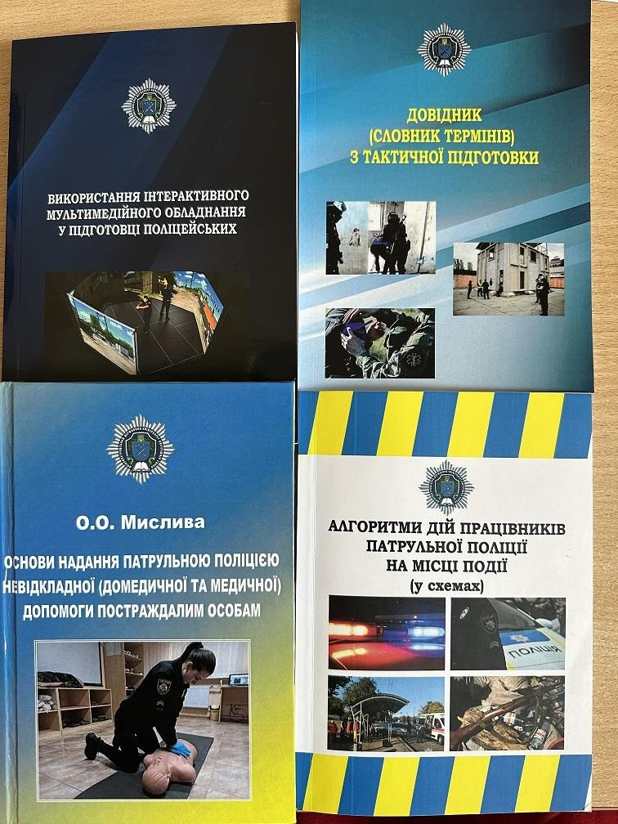
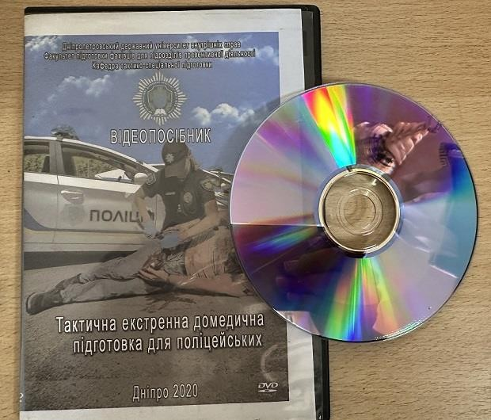
Methodical materials

Slide 36
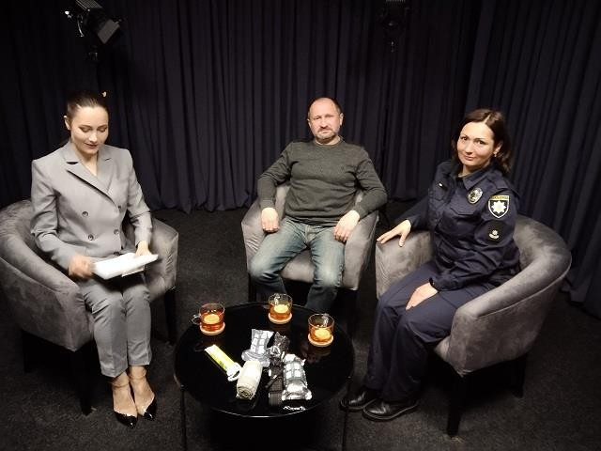
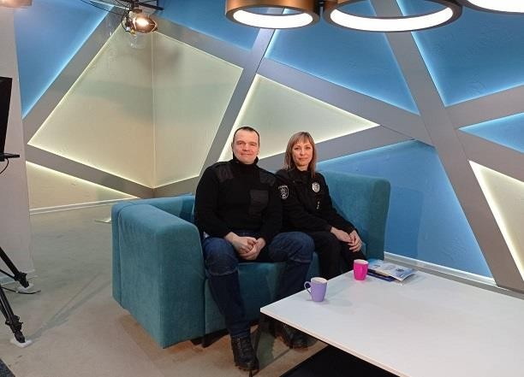
Mass media: education

Slide 37
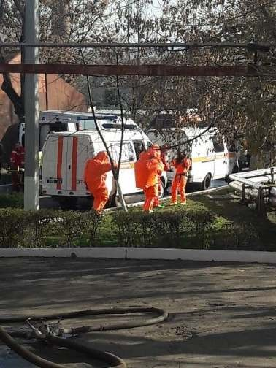
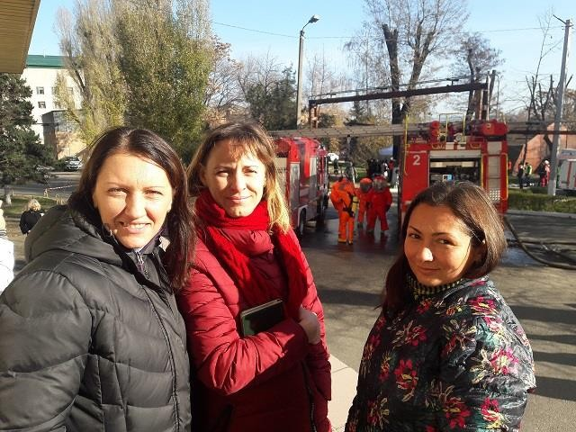
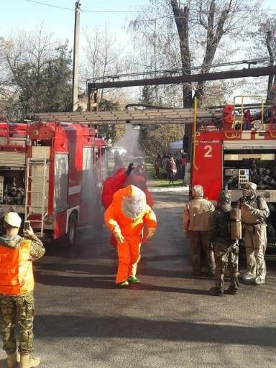
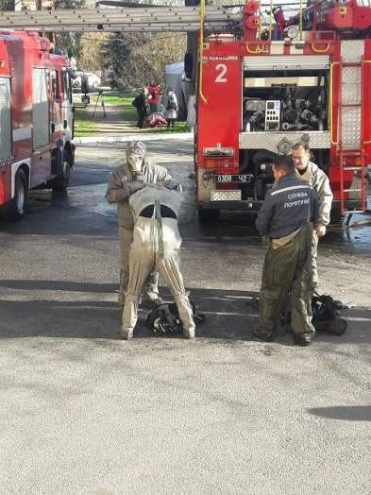
Disaster medicine

Slide 38
Cooperation with MED

Slide 39
Care for the future

Slide 40
We shoot an educational video

Slide 41
We are working on scenarios

Slide 42
Ukraine is on its way to victory!
Thank you for the opportunity,

